Slide 1
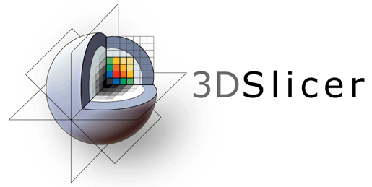
3D Slicer DICOM Tutorial
Requires latest Slicer Preview Release

Slide 2
Prerequisites
Please finish the ‘Data loading and visualization’ tutorial before starting this one: https://www.slicer.org/wiki/Documentation/Nightly/Training#Slicer4_Data_Loading_and_3D_Visualization
Install the TCIABrowser and SlicerRT extensions from the Extension Manager
Download and unzip this dataset: https://github.com/PerkLab/PerkLabBootcamp/raw/master/Data/eclipse-8.1.20-phantom-prostate.zip

Slide 3
Digital Imaging and Communications in Medicine (DICOM)
The industry standard for storage and network transfer of medical images
Freely available
Full documentation: http://medical.nema.org
DICOM tag lookup: http://dicomlookup.com
“Designed by committee” - many device manufacturers collaborate to specify the standard
Very large (about 3500 pages), complex → implementation is difficult
There is no reference implementation or standard conformance test suite
Implementation is always only partial and very often incorrect

Slide 4
Digital Imaging and Communications in Medicine (DICOM)
DICOM file structure
Meta-information header (version, encoding, endianness, etc.)
List of attributes
Attribute name: human-readable name
Tag: 4+4 digit hexadecimal identifier (group+element)
Even group number: standard data
Odd group number: private data (see DICOM conformance statement)
Type: 1 = mandatory, 2=may be empty, 3=may be missing; 1C, 2C, 3C: conditional, it depends on other attributes if required or not
Description: specification of the attribute
Value representation (VR): decimal string, date, time, code string, etc. Special: sequence (SQ) can contain a list of attributes
Value multiplicity (VM): 1, 2, 1-n (string separator: backslash)
Pixel data is stored in an attribute, too

Slide 5
Digital Imaging and Communications in Medicine (DICOM)
Most important parts of the standard
Part 3: Information Object Definitions (IOD): an IOD represents the acquired image (CT, MR, US, etc.); this part specifies the required attributes for each IOD
Part 5: Data Structures and Encoding: definition of how the data is stored in memory, explains private, conditional, sequence, etc.
Part 6: Data Dictionary: tag, name, VR, VM for each attribute

Slide 6
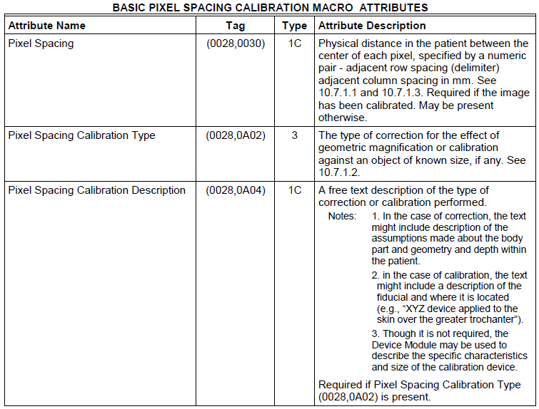
Digital Imaging and Communications in Medicine (DICOM)
Part 3:

Slide 7
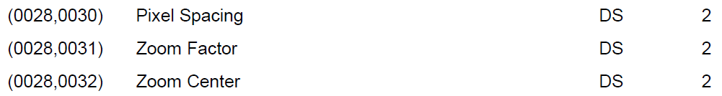
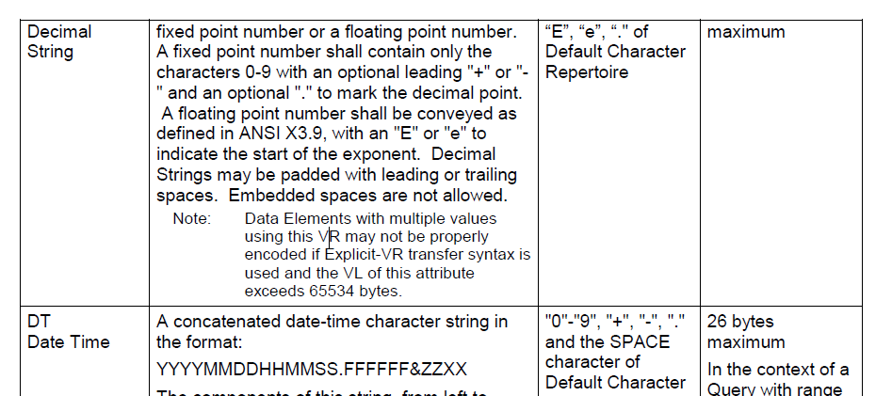
Digital Imaging and Communications in Medicine (DICOM)
Part 6:
Part 5:

Slide 8
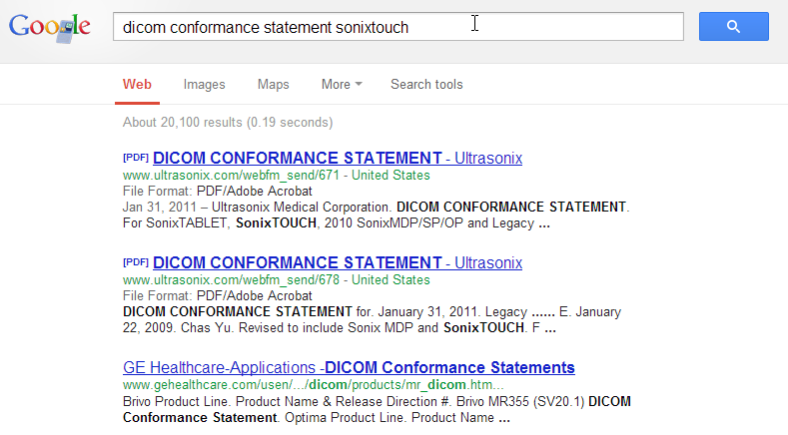
Digital Imaging and Communications in Medicine (DICOM)
DICOM conformance statement
Publicly available for all DICOM compliant devices
Describes what parts of the standard are implemented and specifies all the private fields.

Slide 9
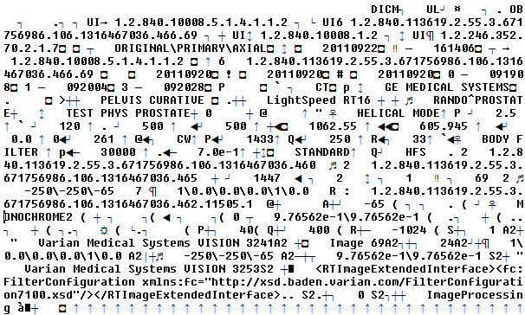
Digital Imaging and Communications in Medicine (DICOM)
Header and attributes are not human-readable

Slide 10
Digital Imaging and Communications in Medicine (DICOM)
Use the free, open-source dcmdump tool to print it in a human-readable form (part of the DCMTK toolkit)
(0008,0008) CS [ORIGINAL\PRIMARY\AXIAL] # 22, 3 ImageType
(0008,0012) DA [20110922] # 8, 1 InstanceCreationDate
(0008,0013) TM [161402] # 6, 1 InstanceCreationTime
(0008,0016) UI =CTImageStorage # 26, 1 SOPClassUID
(0008,0018) UI [1.2.840.113619.2.55.3.671756986.106.1316467036.466.1] # 52, 1 SOPInstanceUID
(0008,0020) DA [20110920] # 8, 1 StudyDate
(0008,0021) DA [20110920] # 8, 1 SeriesDate
(0008,0060) CS [CT] # 2, 1 Modality
(0008,0070) LO [GE MEDICAL SYSTEMS] # 18, 1 Manufacturer
(0008,0090) PN (no value available) # 0, 0 ReferringPhysicianName
(0008,103e) LO [PELVIS CURATIVE] # 16, 1 SeriesDescription
(0008,1090) LO [LightSpeed RT16] # 16, 1 ManufacturerModelName
(0010,0010) PN [RANDO^PROSTATE] # 14, 1 PatientName
(0010,0020) LO [TEST PHYS PROSTATE] # 18, 1 PatientID
…
(0020,0032) DS [-250\-250\105] # 14, 3 ImagePositionPatient
(0020,0037) DS [1\0.0\0.0\0.0\1\0.0] # 20, 6 ImageOrientationPatient
…
(0028,0010) US 512 # 2, 1 Rows
(0028,0011) US 512 # 2, 1 Columns
(0028,0030) DS [9.76562e-1\9.76562e-1] # 22, 2 PixelSpacing
(0028,0100) US 16 # 2, 1 BitsAllocated
(0028,0101) US 16 # 2, 1 BitsStored
(0028,0102) US 15 # 2, 1 HighBit
(0028,0103) US 0 # 2, 1 PixelRepresentation
(7fe0,0010) OW 0018\0018\0018\0018\0018018\0018\0018... # 524288, 1 PixelData

Slide 11
Digital Imaging and Communications in Medicine (DICOM)
Use the free, open-source dcmodify tool to add/remove/modify tags for:
Anonymization (removal of information that can identify the patient)
Fixing of invalid files (e.g., too much info was removed when anonymization was done)
Generating synthetic data sets
dcmodify.exe --modify 0028,0030=0.14\0.14 --modify-from-file 7fe0,0010=image0.raw inputslice1.dcm

Slide 12
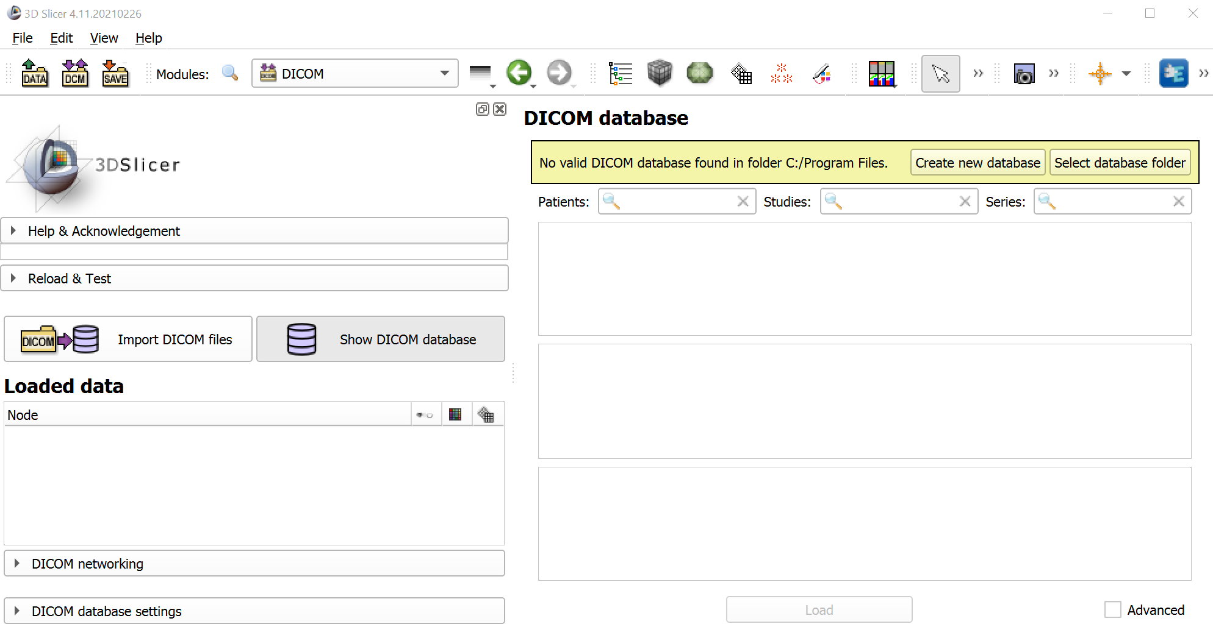

Set up DICOM database
Click “DCM” icon and if offered then click “Create new database” button.

Slide 13
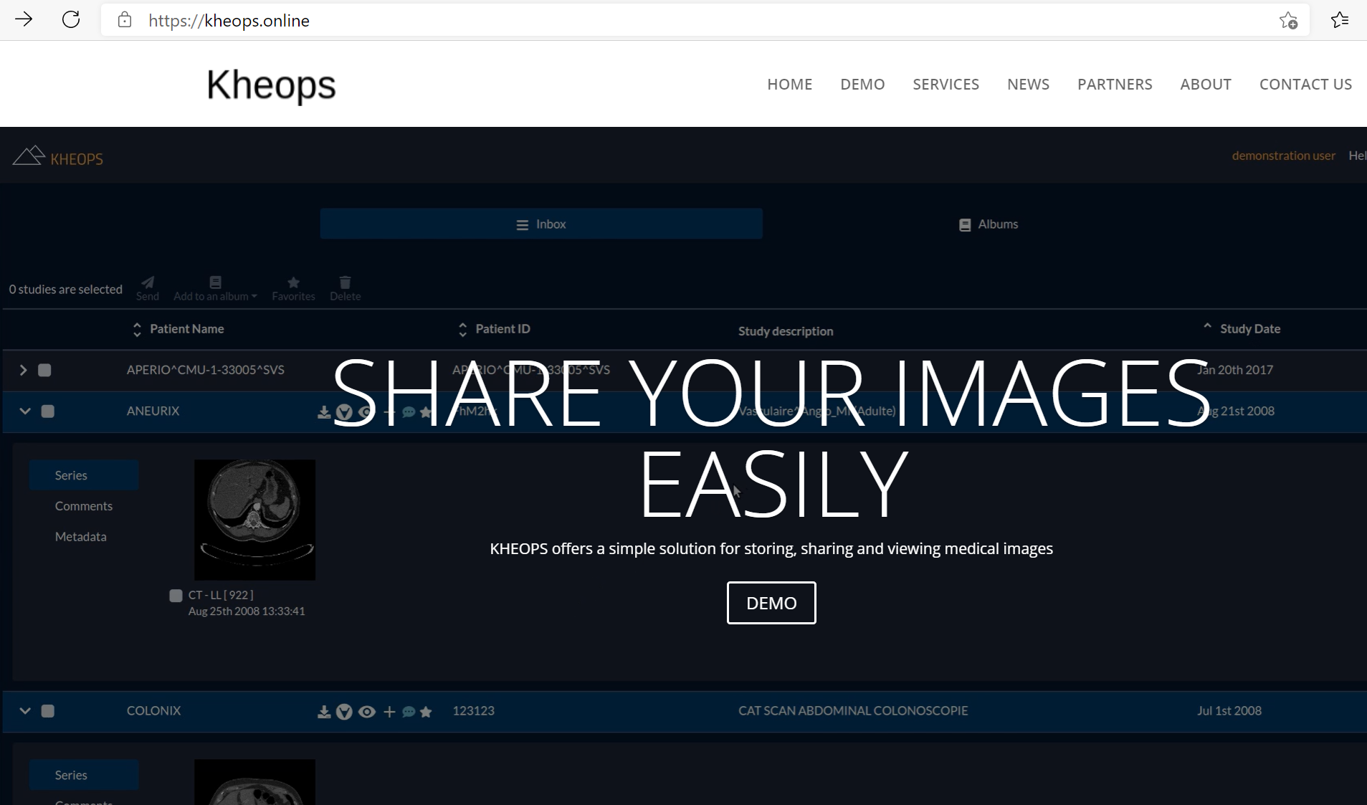
Set up kheops account
Click Demo.
Login with GitHub/Google or register a user.

Slide 14
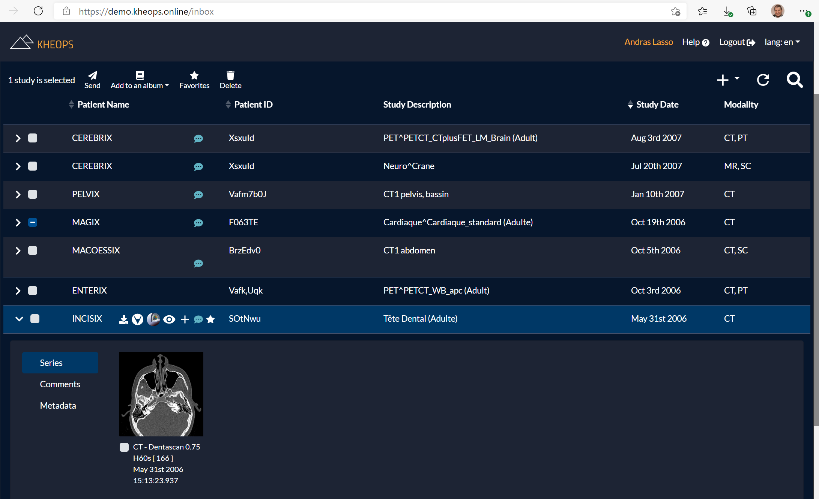
Open study from Kheops /1
Click Slicer icon of study INCISIX.

Slide 15
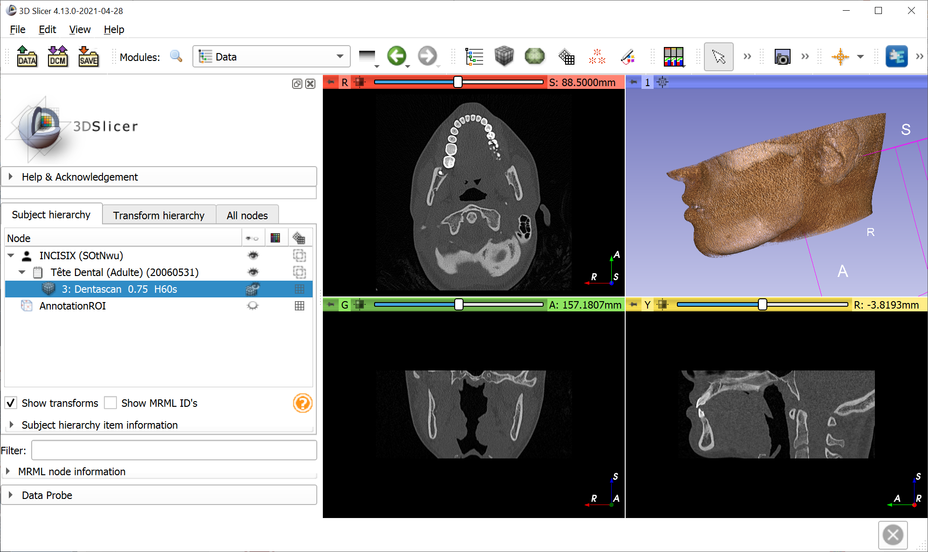
Open study from Kheops /2
Drag-and-drop the volume to 3D view for volume rendering.

Slide 16
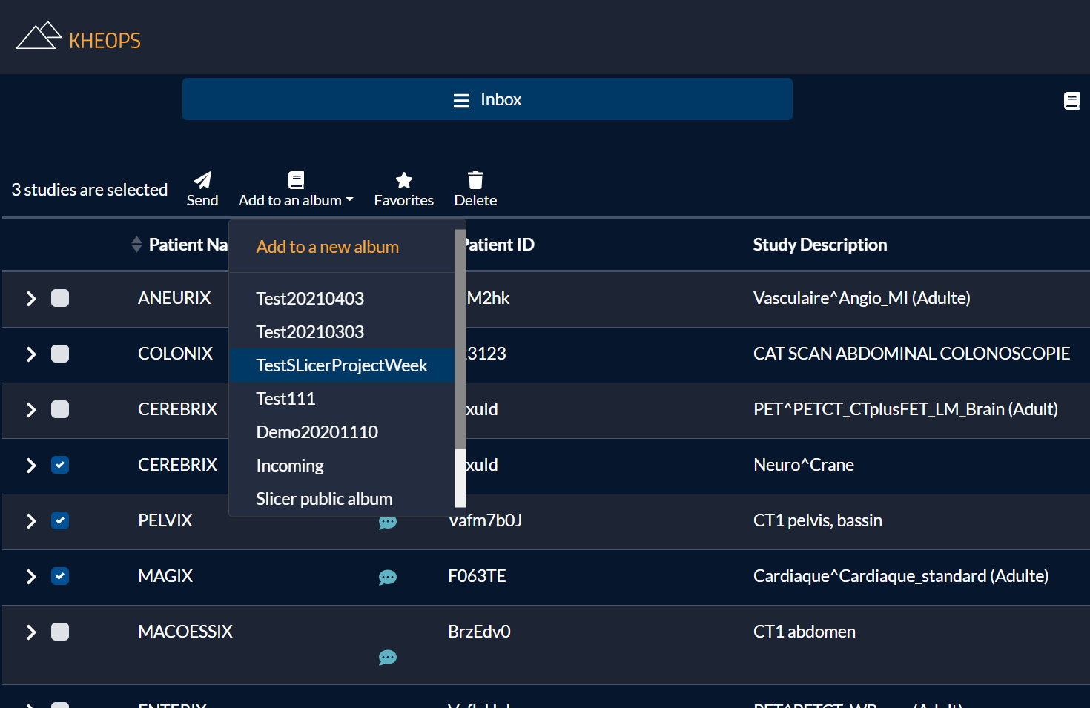
Create new album
Select CEREBRIX, PELVIX, MAGIX.
Add to an album.
Add to a new album.

Slide 17
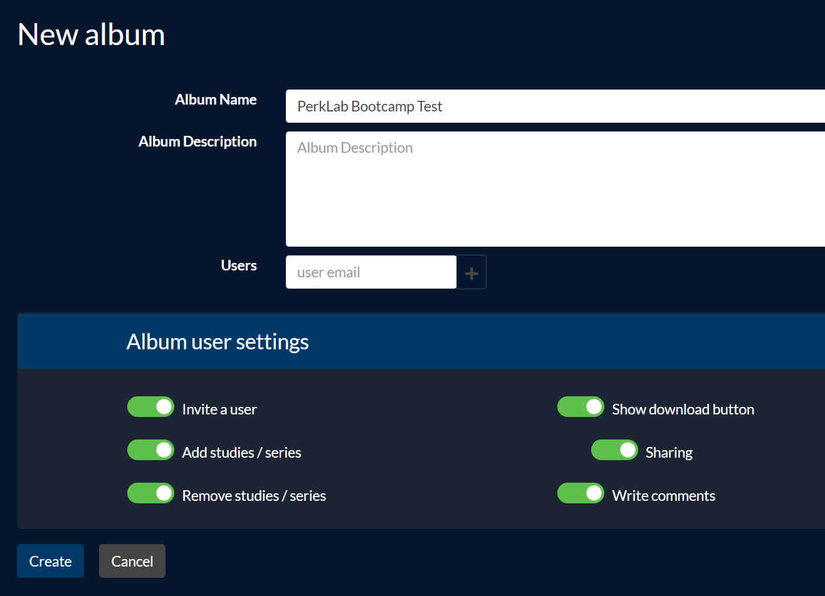
Set album properties
Set Album Name.
Enable all options.
Click Create.

Slide 18
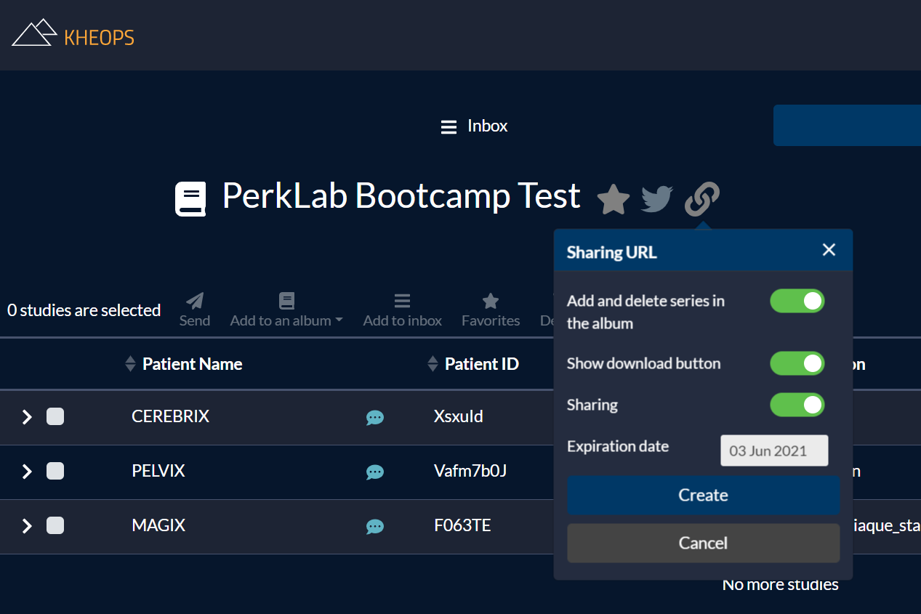
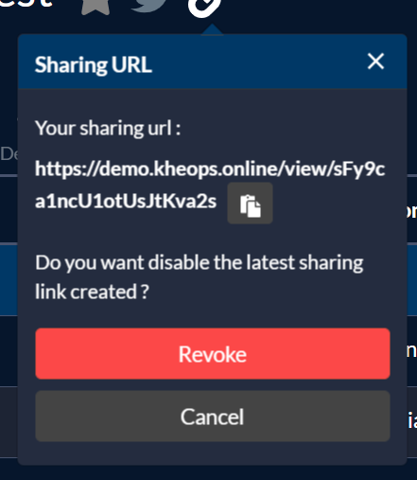
Create sharing link
Click link icon.
Enable all options.
Click Create.
Save the sharing URL.

Slide 19
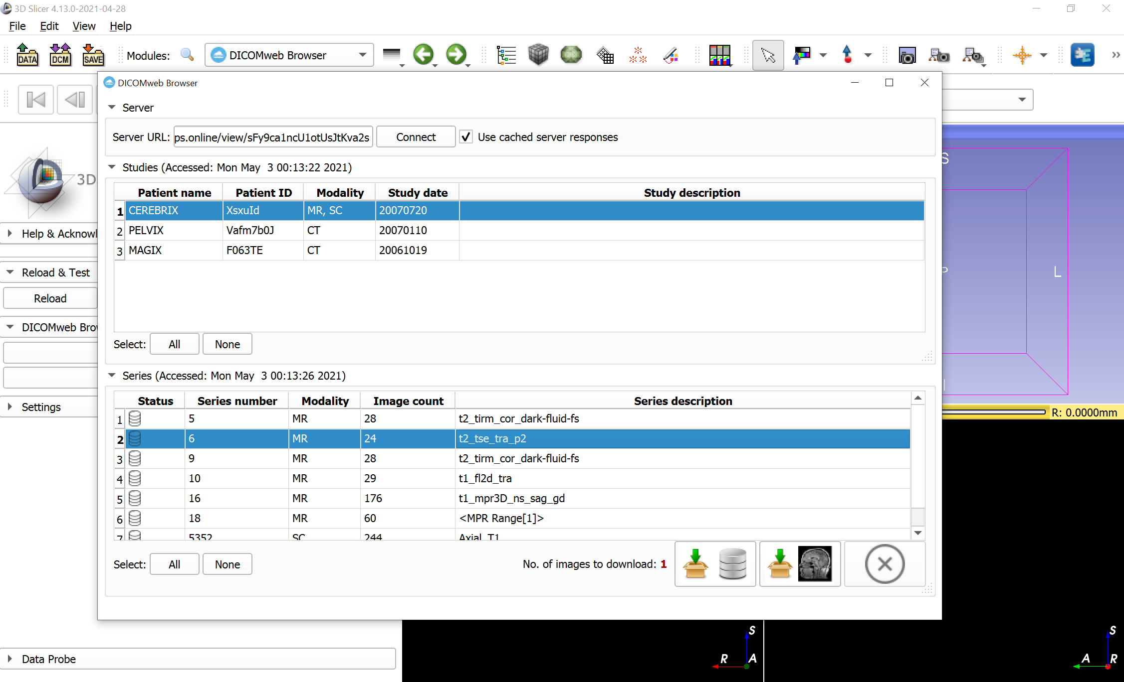
Load using DICOMweb browser
Use sharing link as server URL: https://demo.kheops.online/view/sFy9ca1ncU1otUsJtKva2s
Click Connect.
Select CEREBRIX, series number 6.
Click Download&Load.

Slide 20
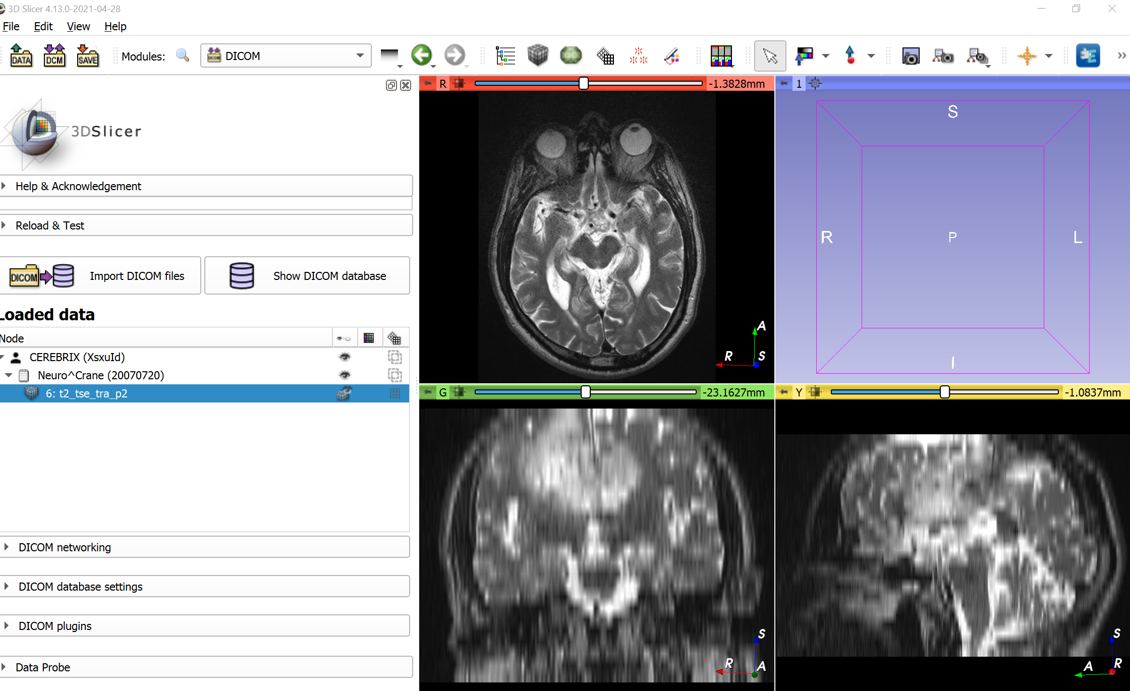
Switch to DICOM module
Notice that the DICOM data is organized in a patient/study/series structure.

Slide 21
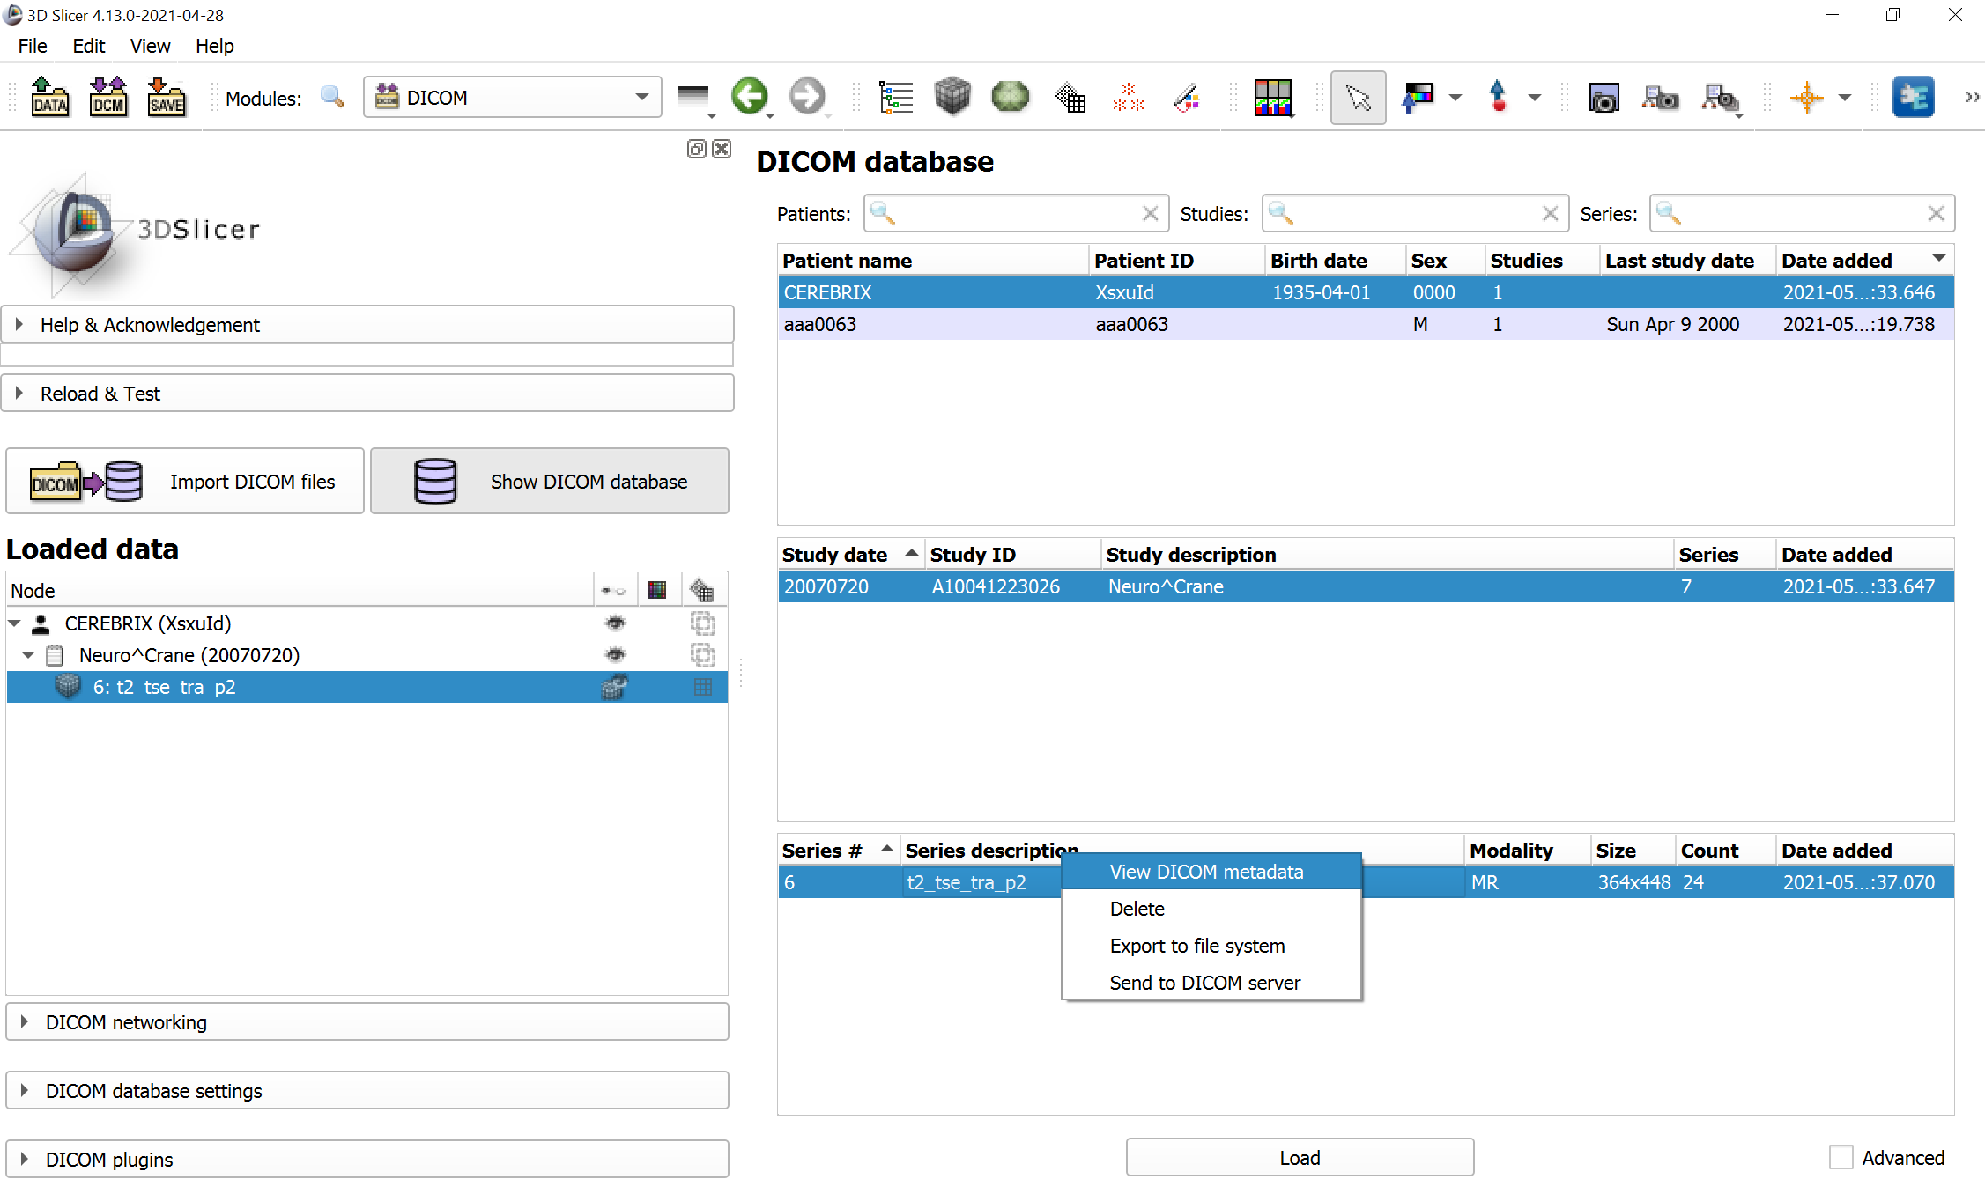
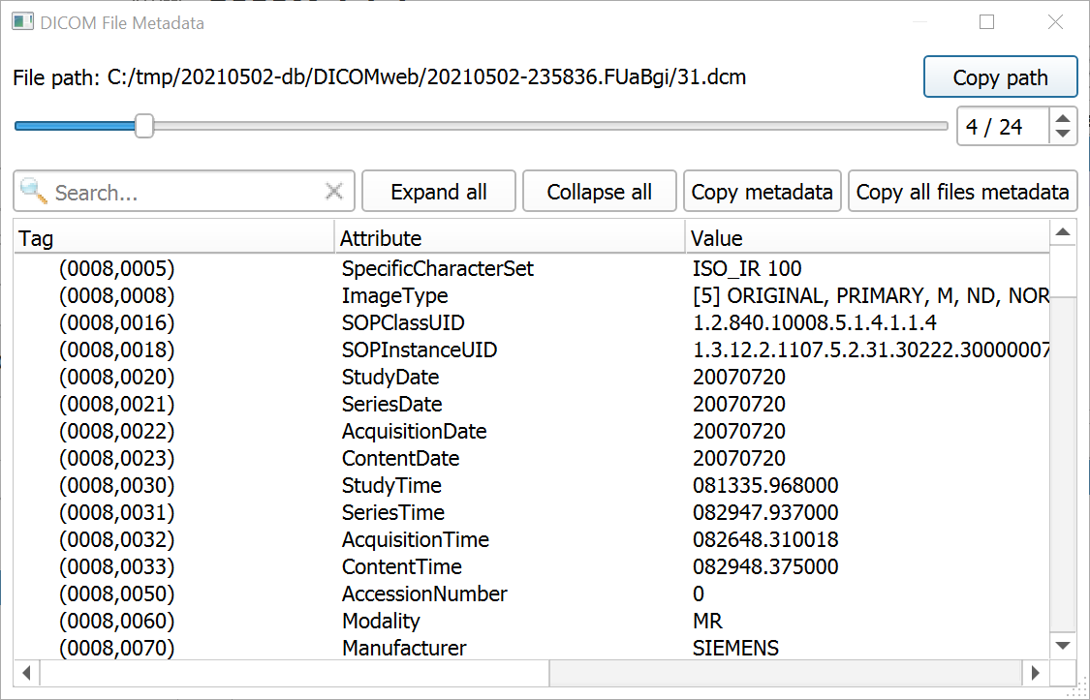
Explore DICOM information
Click Show DICOM database.
Right-click on Series. Click View DICOM metadata.
Double-click the tag to open DICOMLookup.

Slide 22
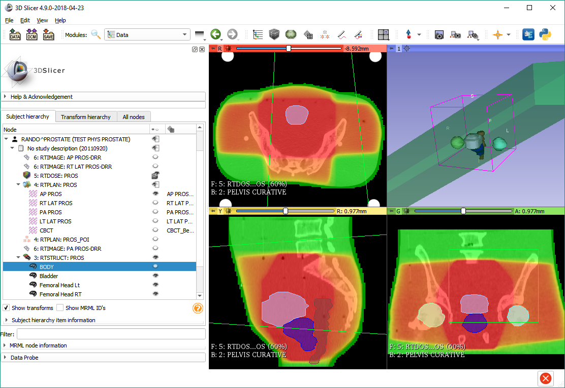
Part 2: Using DICOM data from local storage

Slide 23
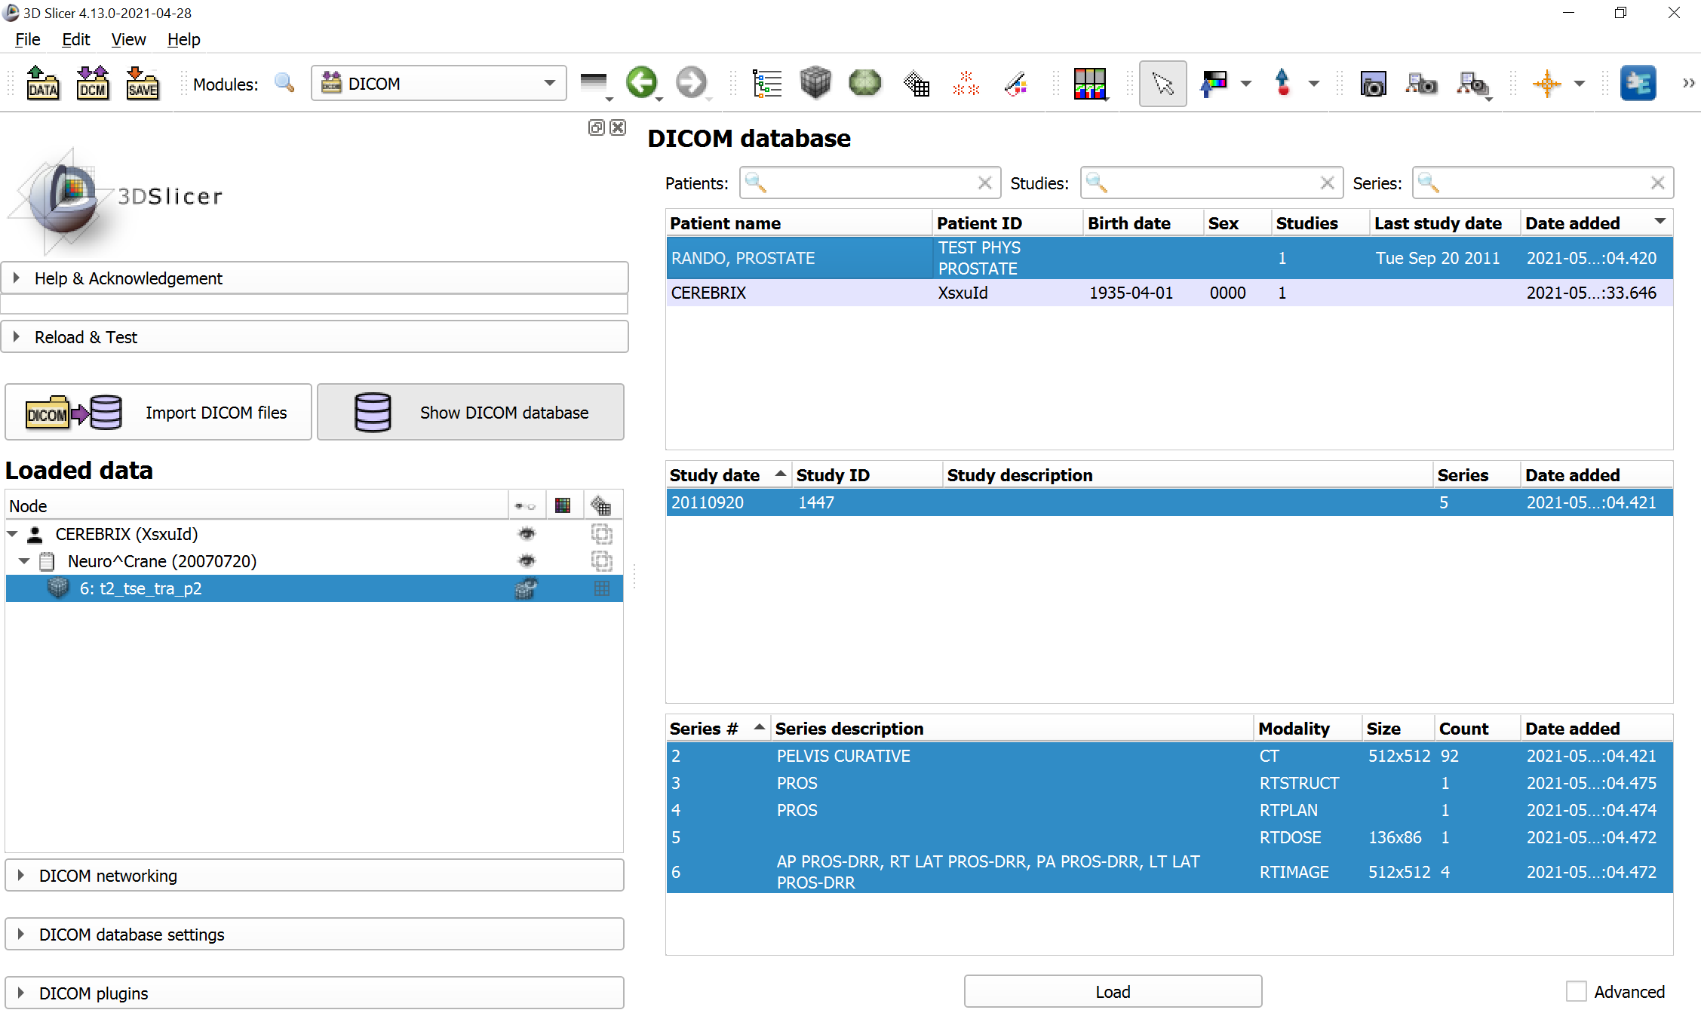
Import DICOM data from disk
Open the DICOM module.
Drag-and-drop folder to the Slicer application window.
When DICOM module is opened then drag-and-dropped files are automatically imported as DICOM.

Slide 24
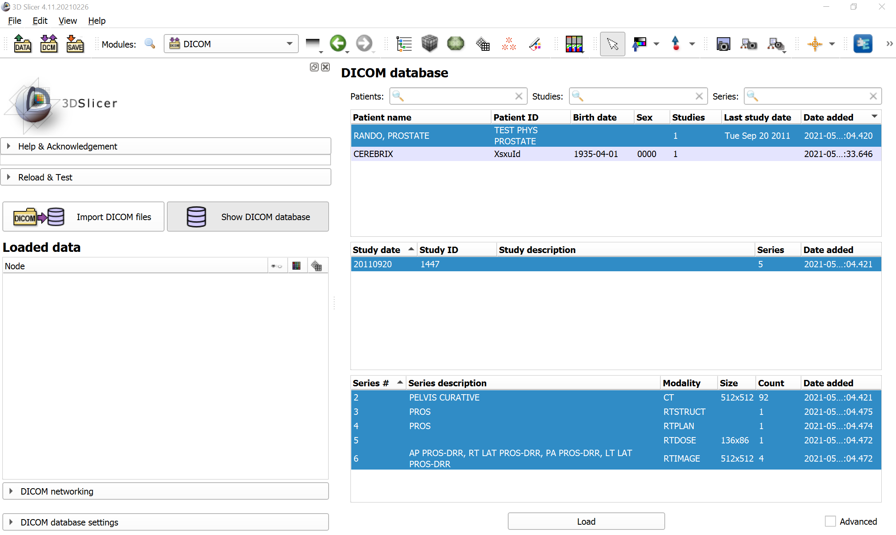
Load prostate phantom RT data
Double-click on the study to load the entire study.

Slide 25
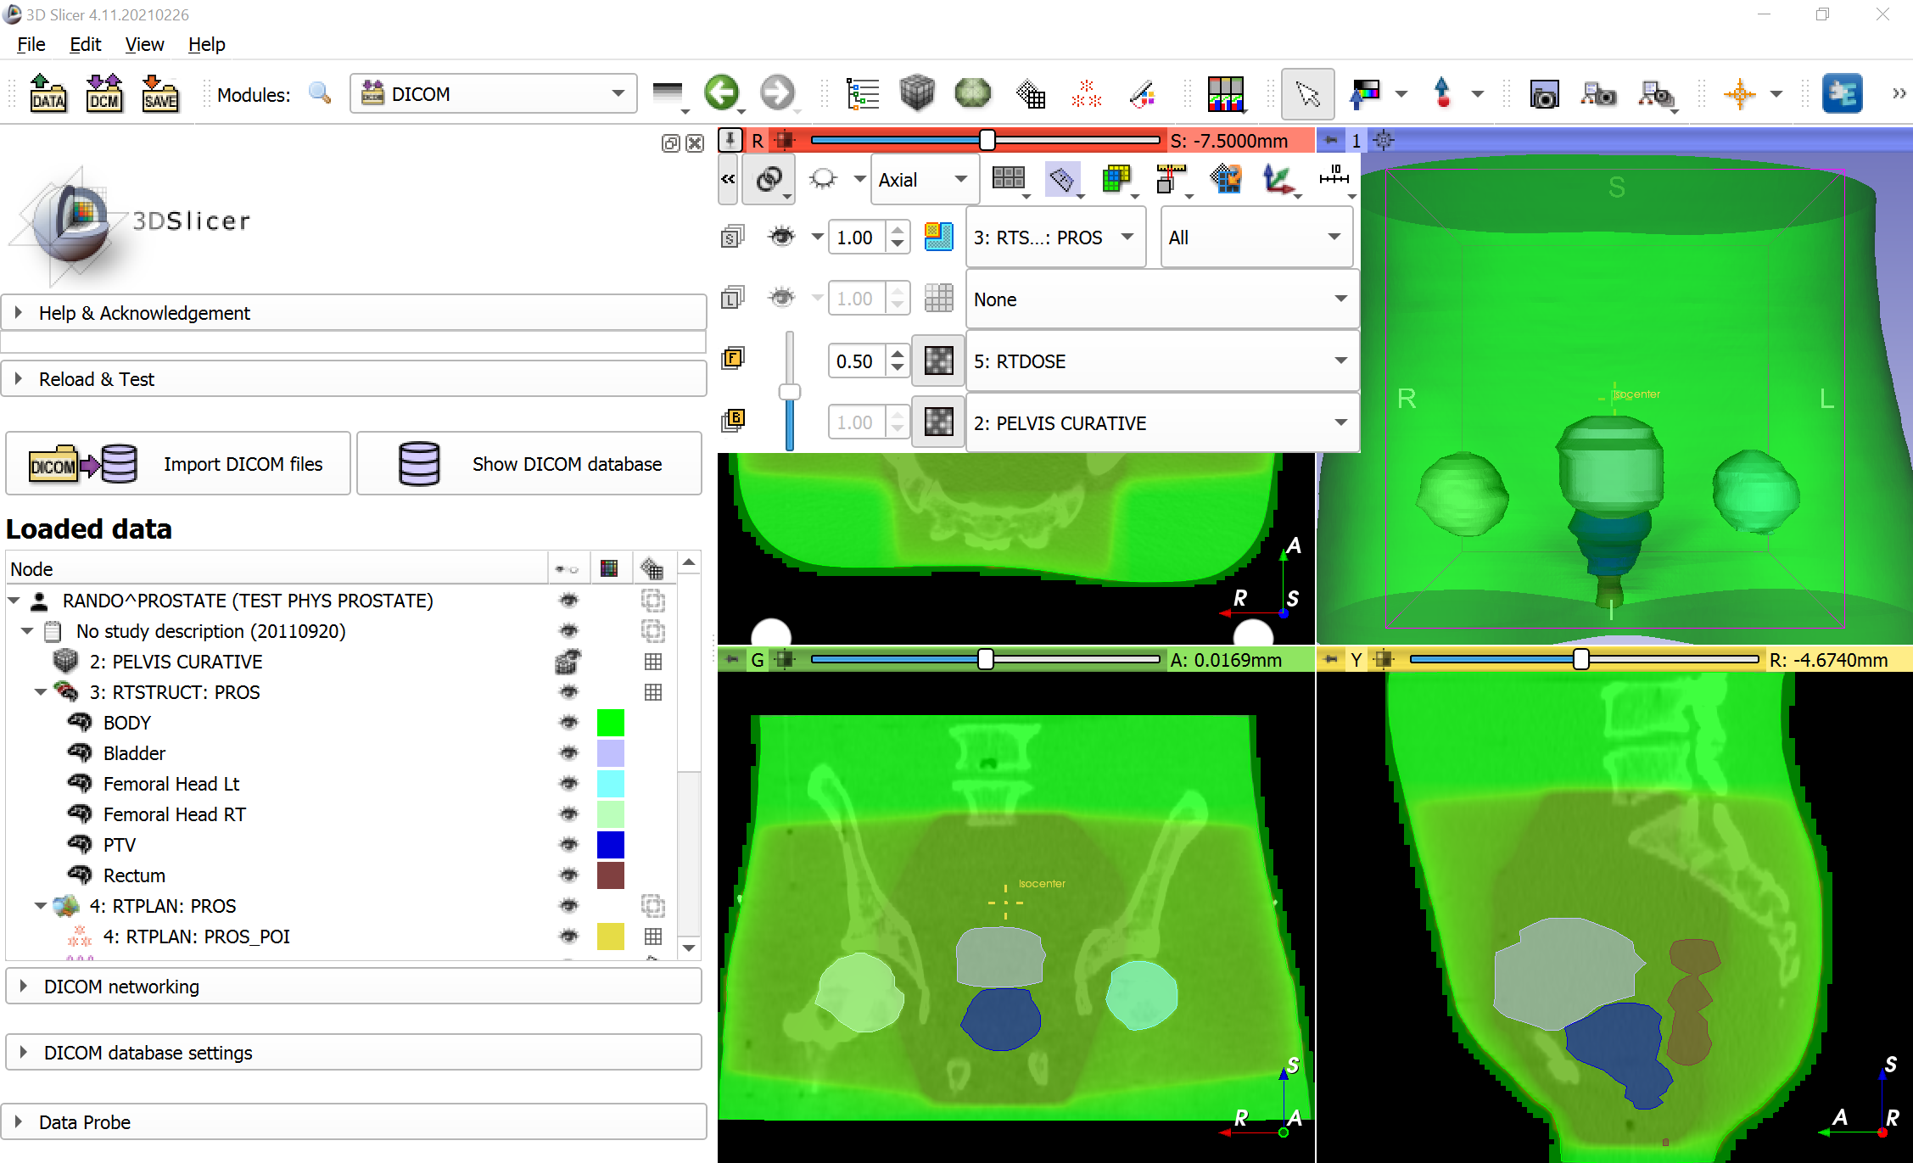
Explore radiotherapy dataset
You can show the dose volume in the foreground layer to overlay it with the anatomy:
Link views.
Select 5 as foreground, 2 as background
Use the slider to adjust opacity.

Slide 26

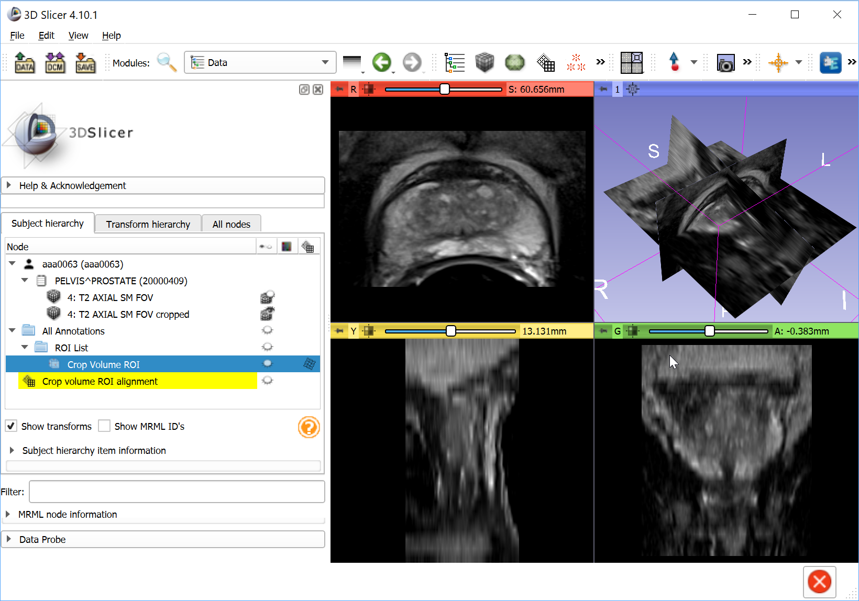
Part 3: Export DICOM
DICOM
import
DICOM
push
Slicer DICOM database
DICOM
query/retrieve
Remote PACS
DICOM files
DICOM
loading
DICOM
export
Slicer scene

Slide 27
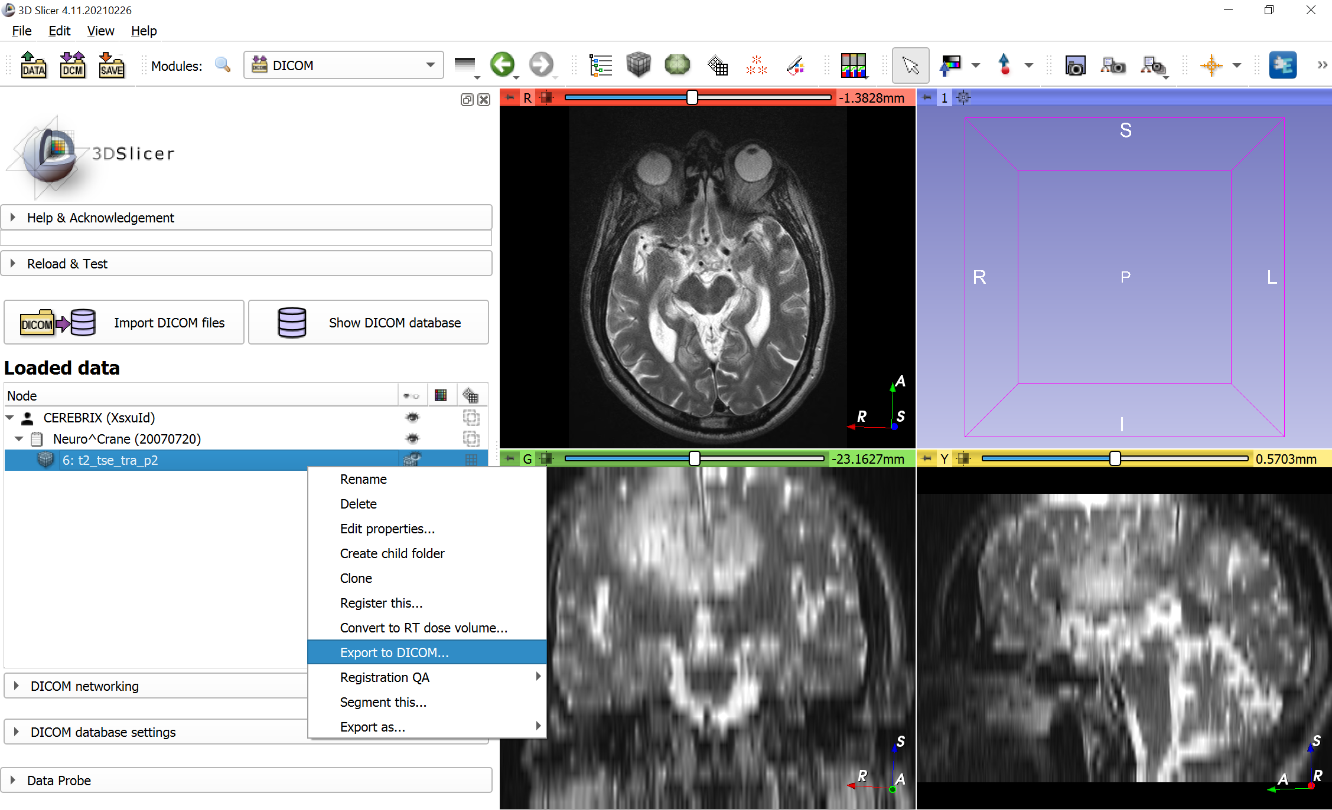
Export image to DICOM files 1

Slide 28
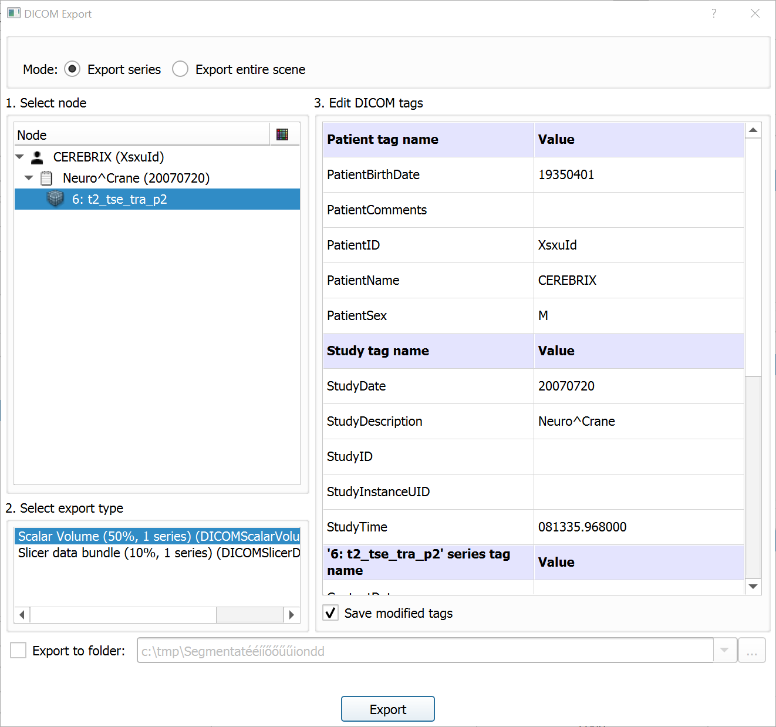
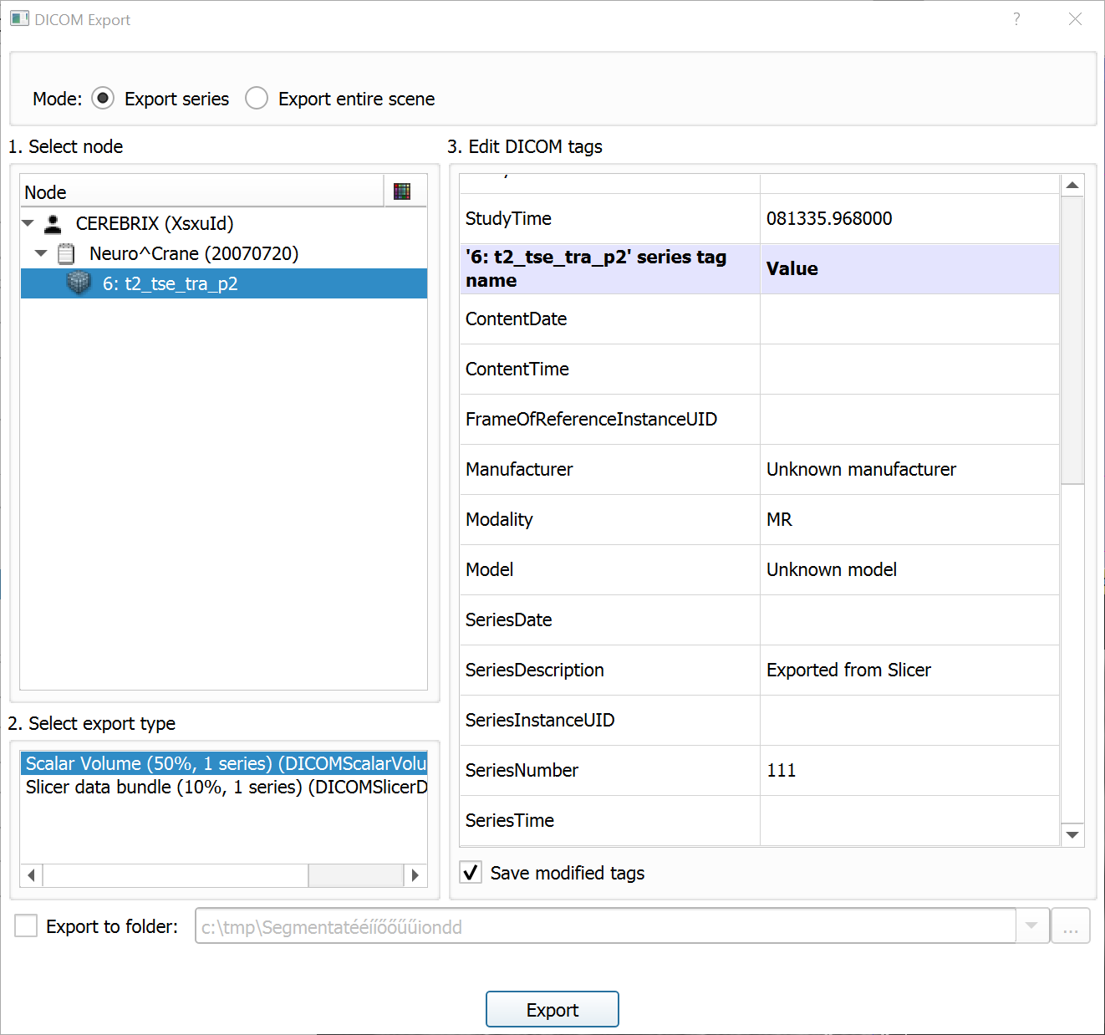
Export image to DICOM files 2
Must to set valid sex (e.g., M)

Slide 29
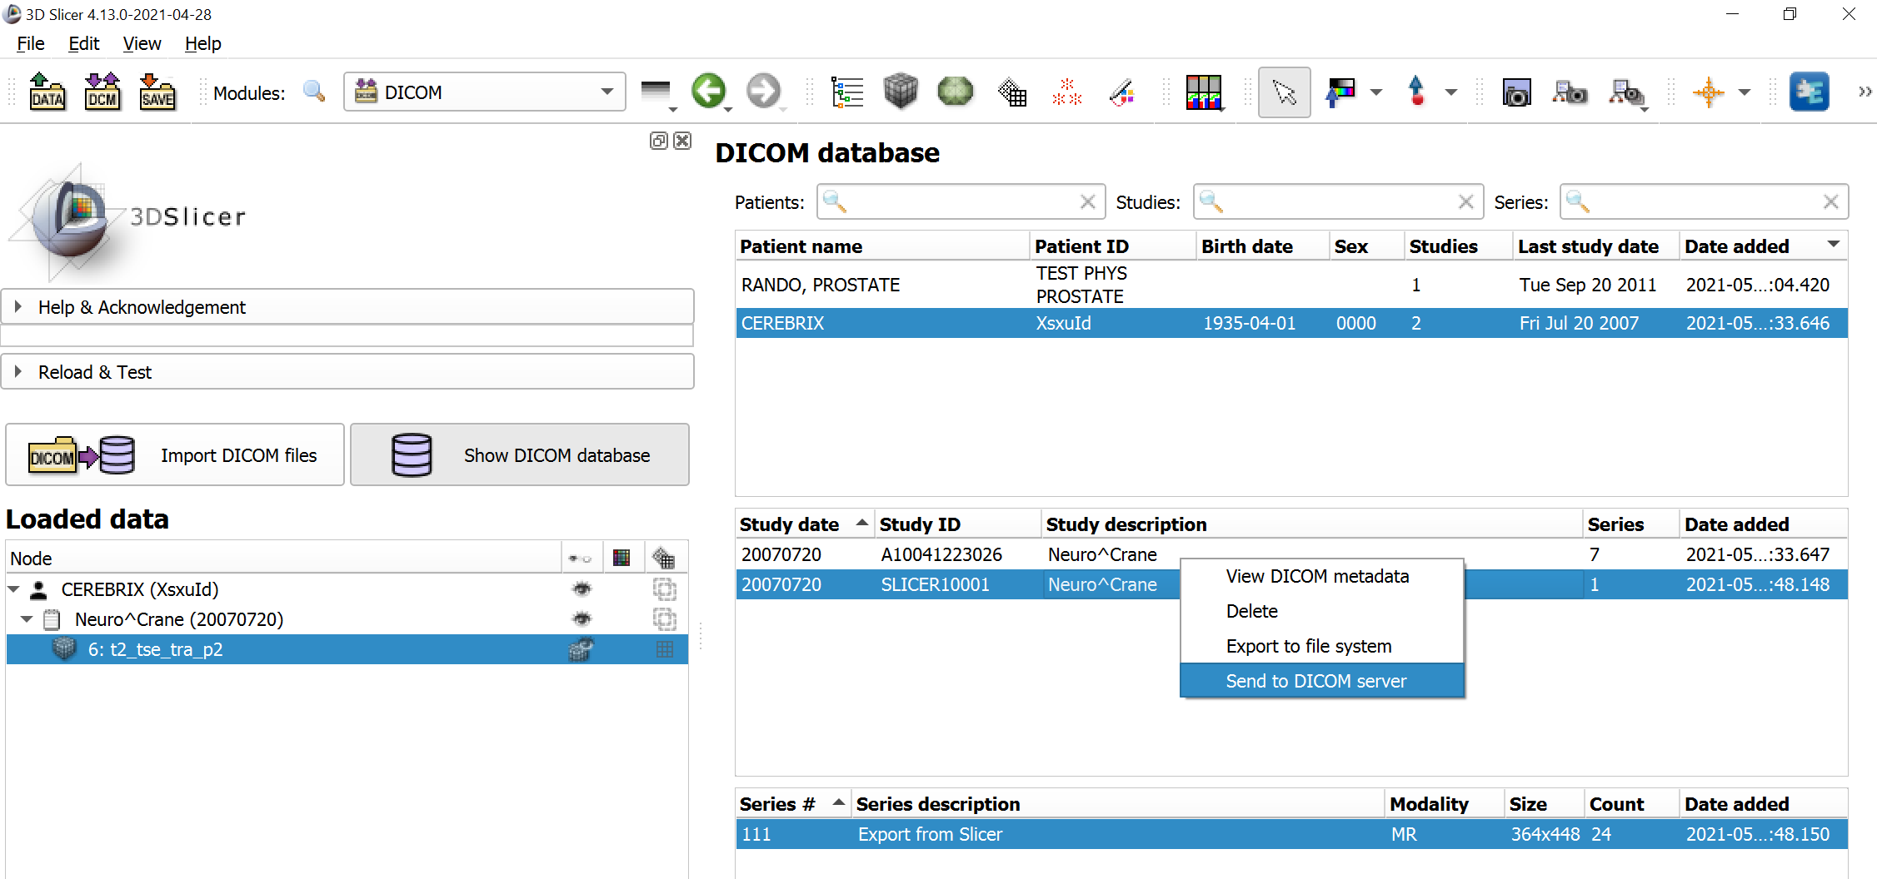
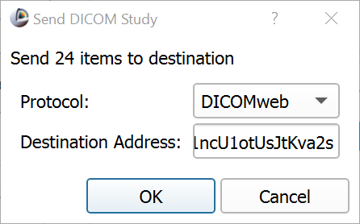
Export image to DICOM files 2
Right-click on the exported study.
Select Send to DICOM server.
Select DICOMweb protocol.
Use Kheops sharing URL as destination address.
Click OK.

Slide 30
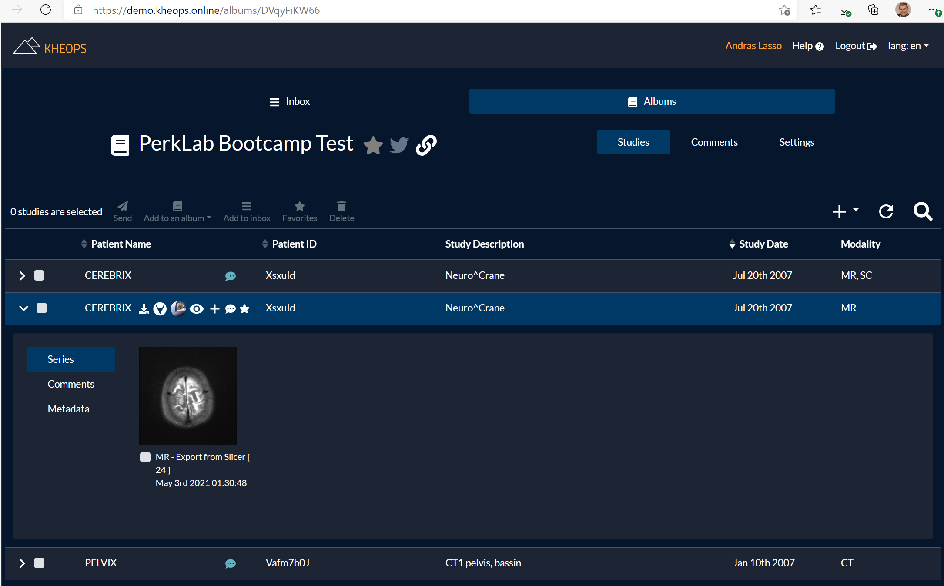
Export image to DICOM files 2

Slide 31
Thanks for participating!

